Slide 1
Mojaloop Community Update
Simeon Oriko
Director of Community
Mojaloop Foundation

Slide 2
Agenda
2023 Community Objectives
Open Source Culture
Speaker Bureau
Mojaloop Community Central

Slide 3
2023 Community Objectives

Slide 4
2023 Community Objectives
Community dimensions and strategy
Define dimensions of the community and come up with a strategy to create a sustainable ecosystem
Deliverables include community survey, engagement plan etc
Community Council Practical Responsibility
Define the practical responsibilities for the community council with a view to influence and expand community engagement.
Deliverables include updated charter, community-led initiatives and programs etc
Growth of OSS contributors
Increase the number of open source developers to contribute to the Mojaloop codebase
Deliverables include contributor onboarding process, updated contribution guidelines, Community outreach events and initiatives etc

Slide 5
Mojaloop & Open Source Culture

Slide 6
Code wins arguments
Notes:
implies an argument
When we’re thinking about building a piece of software, we don’t know how it’s going to turn out. We really don’t. We can speculate, sketch potential structures and collective outlines of what we think we’re going to build, but until we start to build it, we won’t know.

Slide 7
“Talk is cheap. Show me the code.”
- Linus Torvalds
Notes:
implies an argument
When we’re thinking about building a piece of software, we don’t know how it’s going to turn out. We really don’t. We can speculate, sketch potential structures and collective outlines of what we think we’re going to build, but until we start to build it, we won’t know.

Slide 8
“Instead of debating for days whether a new idea is possible or what the best way to build something is, developers would rather just prototype something and see what works”.
Notes:
implies an argument
When we’re thinking about building a piece of software, we don’t know how it’s going to turn out. We really don’t. We can speculate, sketch potential structures and collective outlines of what we think we’re going to build, but until we start to build it, we won’t know.

Slide 9
Code wins arguments
Implies an argument, with a win for the developers who write code…and a loss for someone else

Slide 10
Code wins arguments
moves us forward

Slide 11
Code moves us forward
“Let’s build and see” should be an accepted stage in the process.

Slide 12
Code moves us forward
Problems
Solutions
The project is in the hands of a few engineers
The wider team/community isn’t in the picture, or loses ownership
Trust. Some “letting go” may be necessary
Time-box the project and clearly mark it as an “exploration”
Communicate it supports the project as a whole

Slide 13
Mojaloop Speaker Bureau

Slide 14
Mojaloop Speaker Bureau
A group of people in our community who are approved by the Mojaloop Foundation to speak about Mojaloop at various conferences and events around the world.
Goals/purpose:
Participate in more events across a wider geography
Speak on specialized topics
Provide visibility for Mojaloop smaller members and an independent platform for larger Mojaloop members
Make speaking opportunities less ad hoc and provides transparency and opportunity to community members who would like to speak on behalf of Mojaloop.

Slide 15
Mojaloop Speaker Bureau
Annual application process
Applications are vetted by the Mojaloop Speaker Bureau Program Committee
Final list approved by the Mojaloop Foundation Executive Director
Term is 18 months. You can re-apply if you’d like.
Speaker Bureau list to be published on Mojaloop Community Central
The title “Member of the Mojaloop Foundation Speakers Bureau” can also be used on LinkedIn profiles.

Slide 16
Mojaloop Speaker Bureau
Speaking engagements to be awarded first based on expertise, and then based on geographic vicinity
Speakers will be categorized by topic type (awareness, business/market development, tech etc) and then by level of expertise in each category
Speakers will be selected for a speaking opportunity by the Program Committee and approved by the Mojaloop Foundation’s Executive Director.
Speakers can also identify speaking opportunities and propose them to the Mojaloop Foundation
Proposing a speaking opportunity does not guarantee selection as speaker for that opportunity but preference will be given.

Slide 17
Mojaloop Speakers Bureau
Applications for 2023/2024 open next week!

Slide 18
Mojaloop Community Central

Slide 19
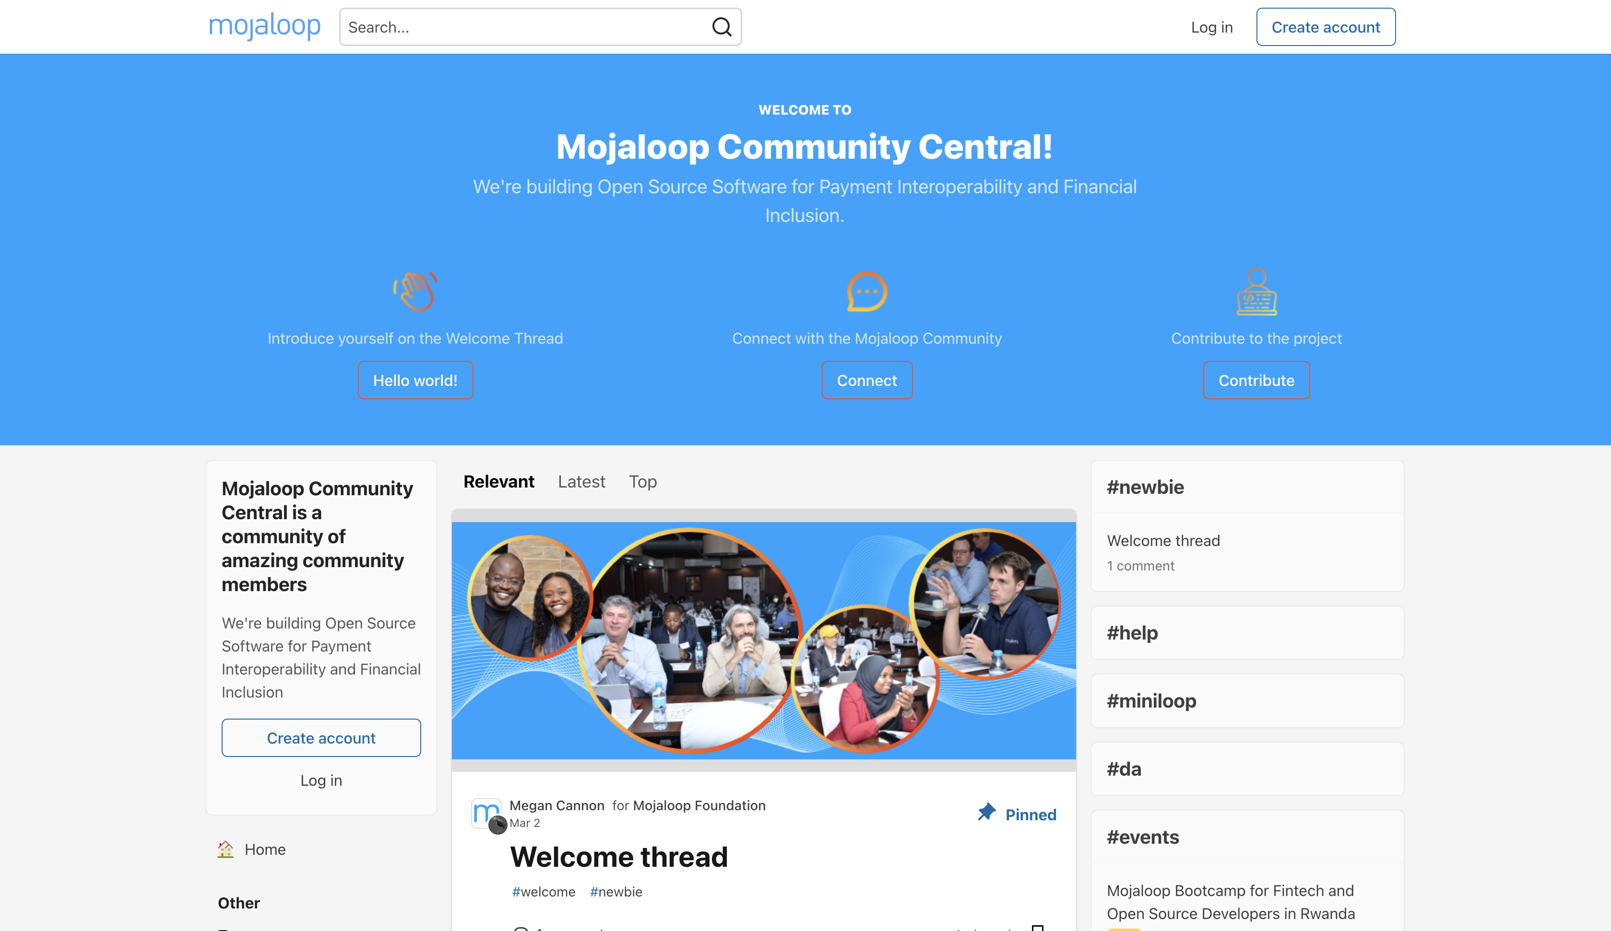

Slide 20
Mojaloop Community Central is live today!
Go check it out! https://community.mojaloop.io

Slide 21
Housekeeping

Slide 22
Community to-do list
Community Central
Sign up at https://community.mojaloop.io
Comment on the Welcome Thread
Mojaloop Speaker Bureau
Look out for announcement next week and consider applying
Community Council
Talk to council members about 2023 objectives and other ideas you’d like them to discuss at CoCo meetings
Culture
What would a “Code moves us forward” culture look like in community workstreams or governance?

Slide 23
Thank you!
soriko@mojaloop.io

